Slide 1
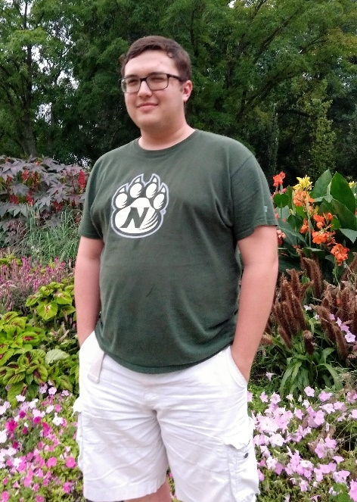
Using ProDiscover
Connor Crossen and Blake Newland

